Slide 1
Protecting Users
Pavel Dmitriev, Microsoft Analysis & Experimentation
Presented by paul raff
Strata 2018 tutorial
Notes:
Current: 14:00

Slide 2
The Challenge
As more and more experiments are run, possibility of user harm increases
Less manual monitoring of experiments
Buggy feature or a bad idea may make it to real users
Interactions are possible between concurrently running experiments
Experimentation system itself may have issues and can hurt users (link)
Need to minimize harm to users!
If you have to kiss a lot of frogs to find a prince, find more frogs and kiss them faster and faster -- Mike Moran, Do it Wrong Quickly
Notes:
1:30

Slide 3
Fast Auto-Detection and Shutdown of Bad Experiments
Experimentation system needs to
Automatically analyze scorecards
Detect bad experiments
Send alerts to experimenters
In cases of extreme badness, shut down the experiment automatically
The challenge is doing it fast (seconds to minutes)
Requires a real-time data pipeline
Data in the beginning of experiment may be noisy
Small amount of data
Easily dominated by a few very active users or bots
Aggregating from event-level to user-level helps reduce false positives
Notes:
Exp system needs to not just report out the results, but be able to analyze and take action based on the results.
Ex: bot that generated 100 queries in the first 30 seconds
2:00

Slide 4
Starting Small
Start with a small percentage, e.g. 0.5%
This should be enough to detect outrageously bad experiments
Once verified that things look Ok, can [automatically] ramp up
Run experiment with partial exposure
E.g. only on 1 out of 10 queries in the treatment actually gets served treatment experience
Once verified that things look Ok, ramp up the exposure to 100%
The advantage is that no single user can be stuck in a bad experience for a long time
The disadvantage is inconsistent user experience, and dilution to user-level metrics
Notes:
1:45

Slide 5
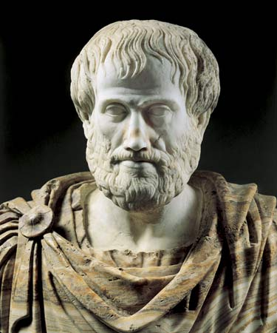

Prevent and Detect Interactions
Interaction happens if an effect of exposing users to several experiments at the same time is not the same as adding up the effects of individual experiments
“The whole is greater than the sum of its parts”
-Aristotle
“I told about the whole being greater than the sum of its parts. It's that way with people, too, he said, only with people it's sometimes that the whole is less than the sum of the parts.”
-Wendelin Van Draanen,
Flipped
Notes:
1:00

Slide 6
Prevent and Detect Interactions
Interaction happens if an effect of exposing users to several experiments at the same time is not the same as adding up the effects of individual experiments
Example (antagonistic): E1 changes font to blue, E2 changes background color to blue
Example (synergetic): E1,…,EN make page header more convenient on page1,…,pageN
Our experience is that, when prevention setup is in place, interactions are rare
About a dozen interactions per year in Bing, with over 10,000 experiments run
Notes:
1:30

Slide 7
Interaction Prevention
When suspecting an interaction:
Run experiments sequentially (slow)
Run non-overlapping experiments (two experiments need to use the same hash seed, and get assigned to different portions of the hash space)
E1
E1
E2
hash1 space
hash3 space
f(hash1,uid1)
E2
f(hash3,uid1)
f(hash2,uid1)
hash2 space
user
(uid1)
user
(uid1)
Overlapping Experiments
Non-overlapping Experiments
Notes:
2:30

Slide 8
Interaction Detection
Given two overlapping experiments: E1(T1,C1), E2(T2,C2) and a metric M, there’s an interaction if the results for M in E1 are stat. sig. different in the segment of users who are in T2 compared to the segment of users who are in C2.
Note: need to run it for all pairs of overlapping experiments.
Complexity= O(#metrics*#experiments^2)
Need to control for type I errors (e.g. Bonferroni Correction)
T2
(T1-C1 | T2) =?= (T1-C1 | C2)
T1
C1
C2
All E1 Users
Notes:
2:00

Slide 9
Summary
Automated methods to protect users are required as the number of experiments ramps-up
Experimentation system should not just report out the results, but should auto-analyze them and take action:
Send alerts
Auto-shutdown bad experiments
Start small and ramp-up
Prevent and detect interactions
Notes:
0:45

